Slide 1

Introduction to Operating Systems CS/COE 1550
Fall 2021
Sherif Khattab
ksm73@pitt.edu
(Some slides are from Silberschatz, Galvin and Gagne ©2013)

Slide 2
Announcements
Upcoming deadlines:
Quiz 1 and Homework 4: due 10/8
Lab 2: due on 10/18
Project 2: due on 10/22

Slide 3
Last Lecture …
Monitors and Condition Variables
How to use
How to implement (user-level implementation of Hoare semantics)

Slide 4
Muddiest Points

Slide 5
Today …
Other synchronization mechanisms
Classical Process Synchronization Problems
Semaphore-based solutions

Slide 6
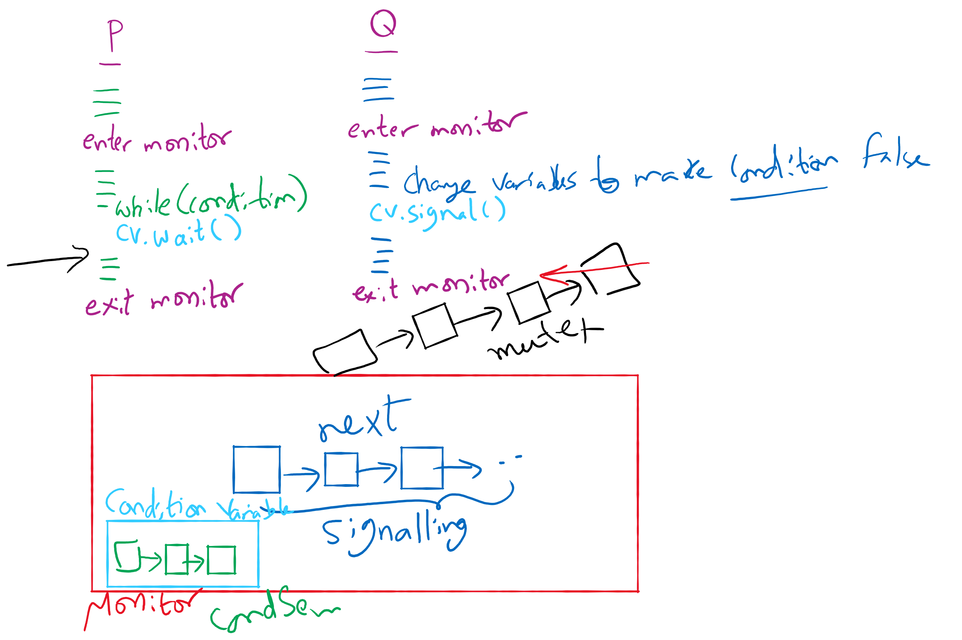
Process Synchronization inside Monitors

Slide 7
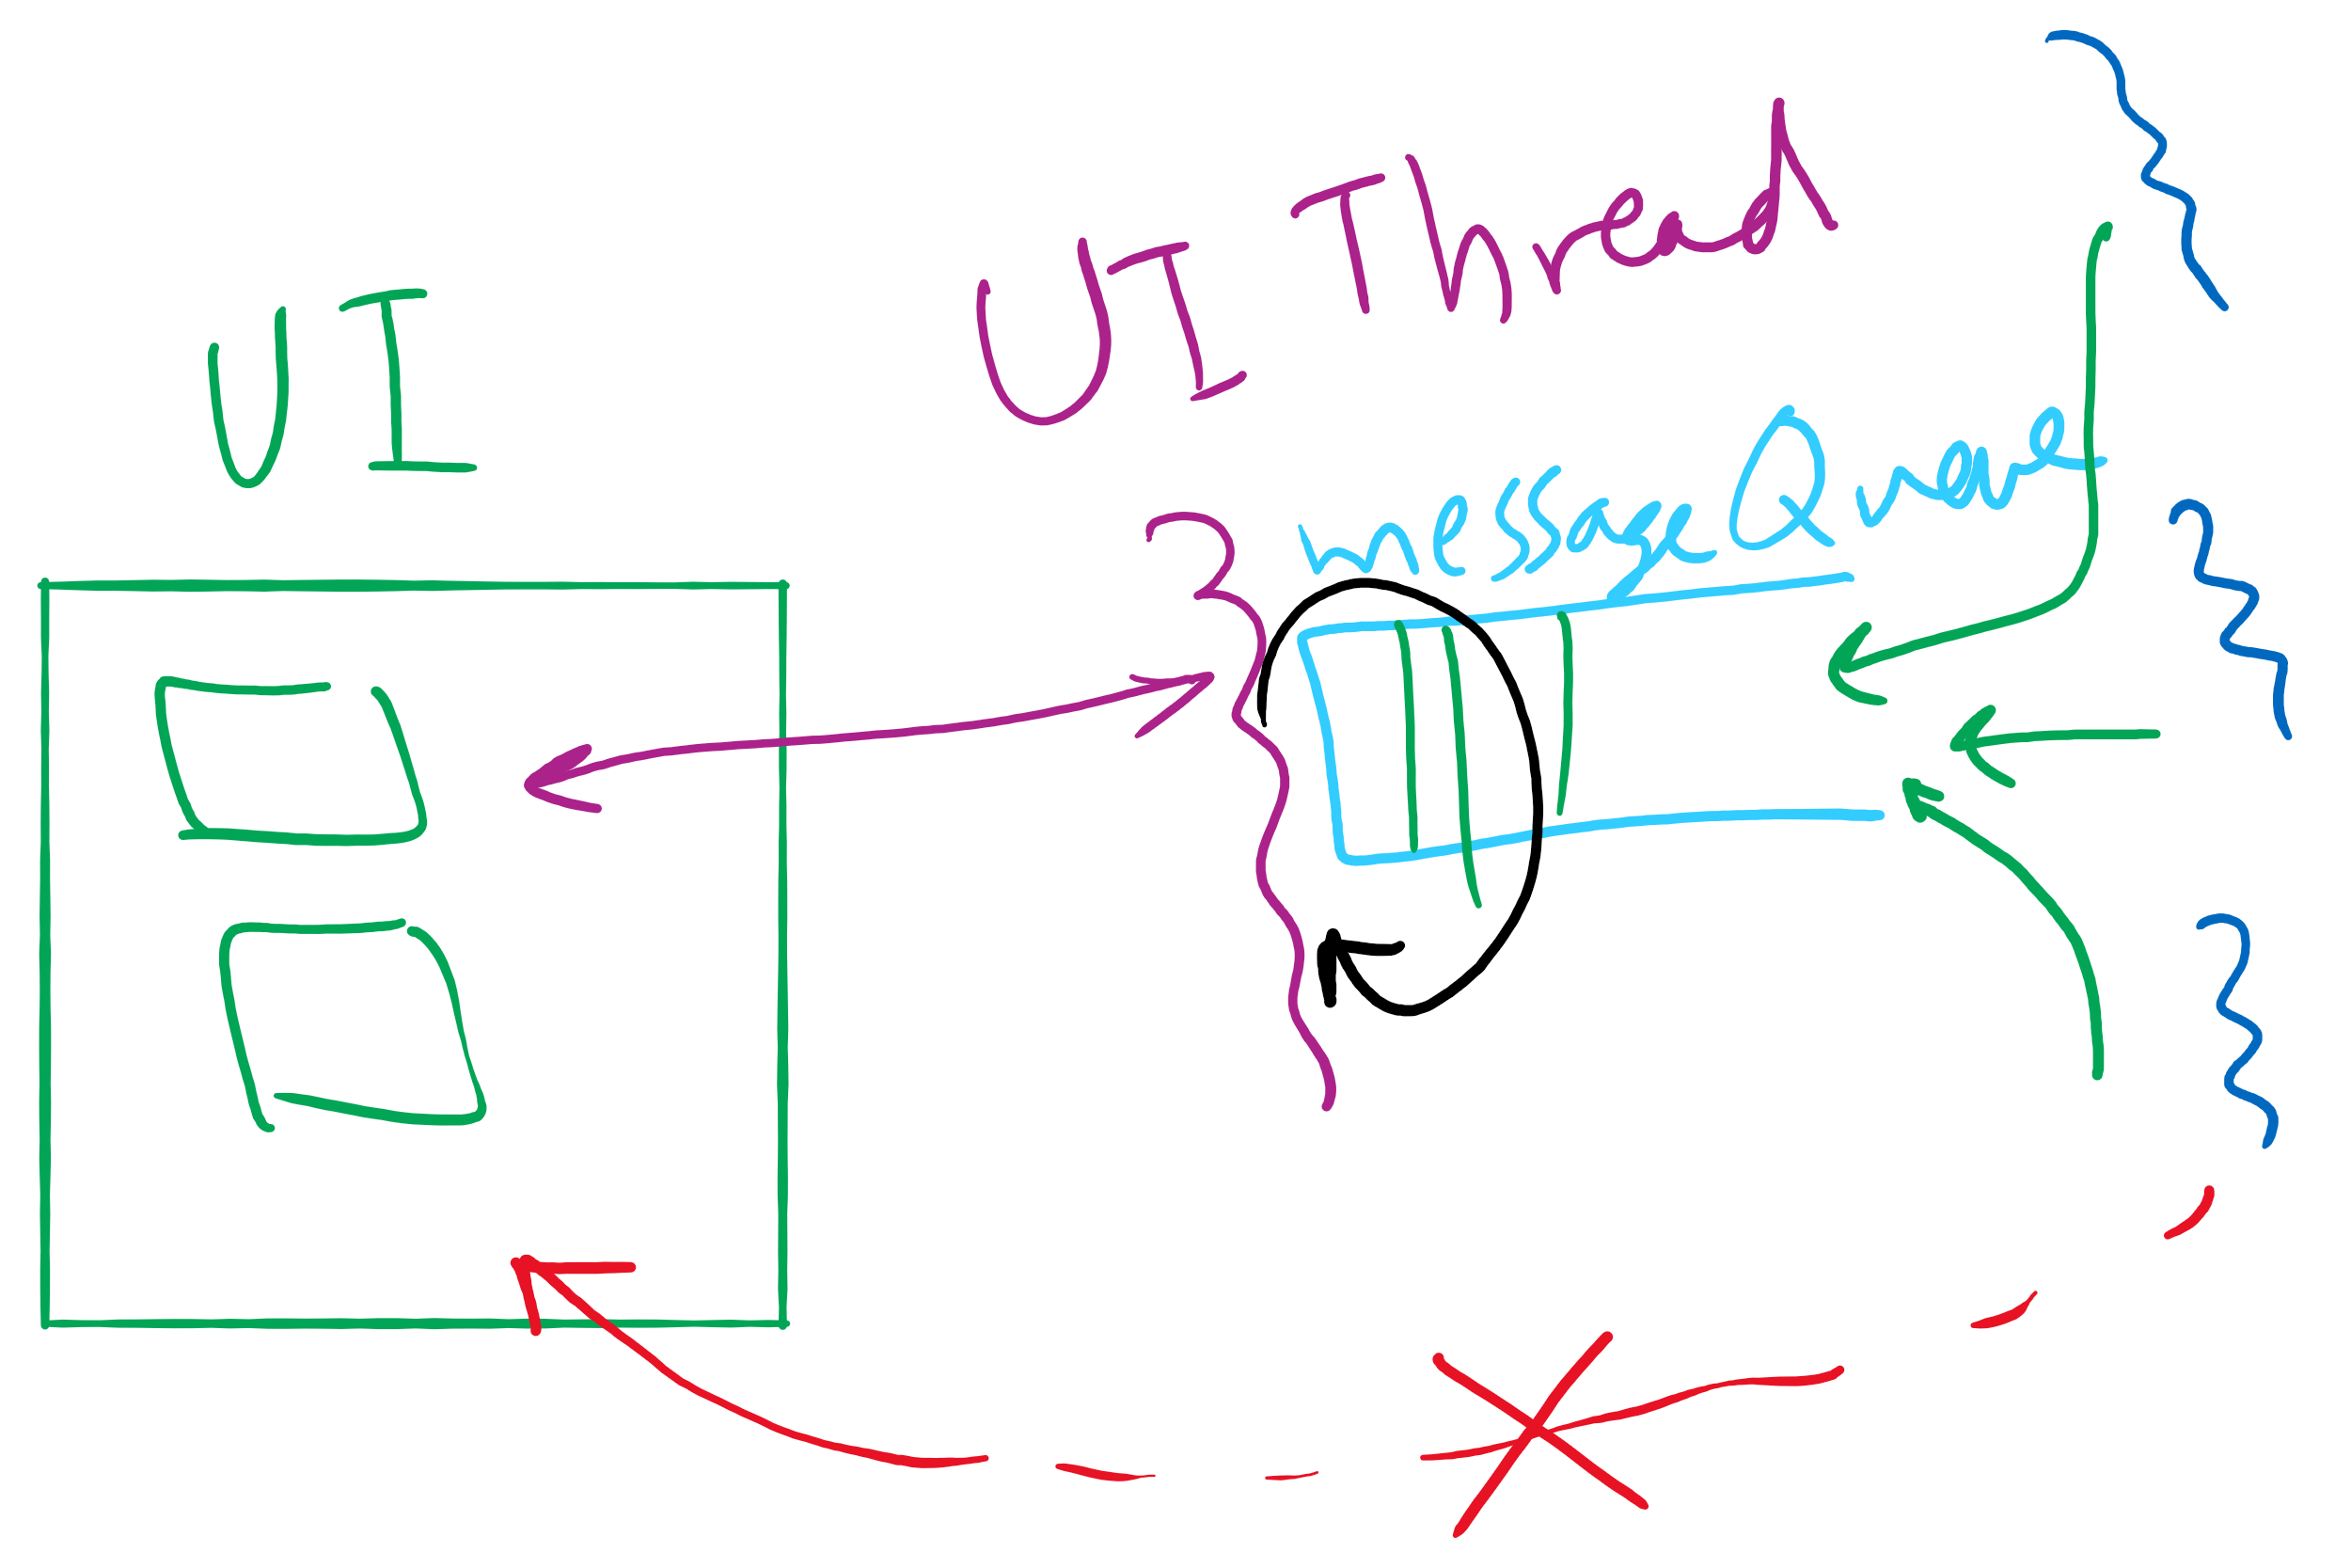
Message passing
Synchronize by exchanging messages
Two primitives:
Send: send a message
Receive: receive a message
Both may specify a “channel” to use
Issue: how does the sender know the receiver got the message?
Issue: authentication

Slide 8
Barriers
Used for synchronizing multiple processes
Processes wait at a “barrier” until all in the group arrive
After all have arrived, all processes can proceed
May be implemented using locks and condition variables
A
A
A
A
B
B
B
B
C
C
C
C
D
D
D
D
Processes approaching
barrier
B and D at
barrier
All at
barrier
Barrier releases all processes

Slide 9
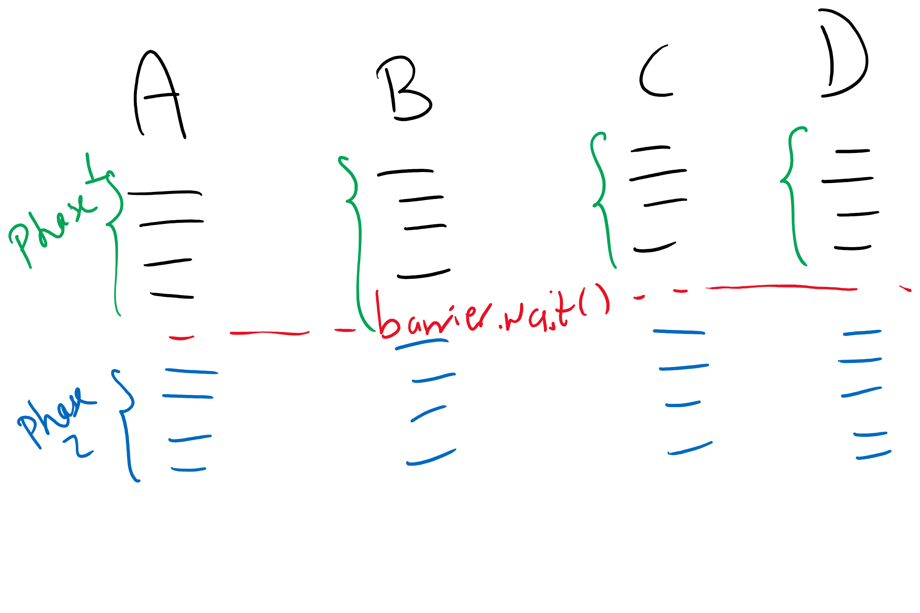
Barriers Example

Slide 10
Xv6 Walkthrough
sleep and wakeup

Slide 11
Classical synchronization problems
Bounded Buffer
Multiple producers and consumers
Synchronize access to shared buffer
Readers & Writers
Many processes that may read and/or write
Only one writer allowed at any time
Many readers allowed, but not while a process is writing
Dining Philosophers
Resource allocation problem
N processes and limited resources to perform sequence of tasks
Goal 1: use semaphores to implement solutions to these problems
Goal 2: use locks and condition variables to implement solutions to these problems

Slide 12
Bounded buffer problem
Goal: implement producer-consumer without busy waiting

Slide 13
Thread spawning

Slide 14
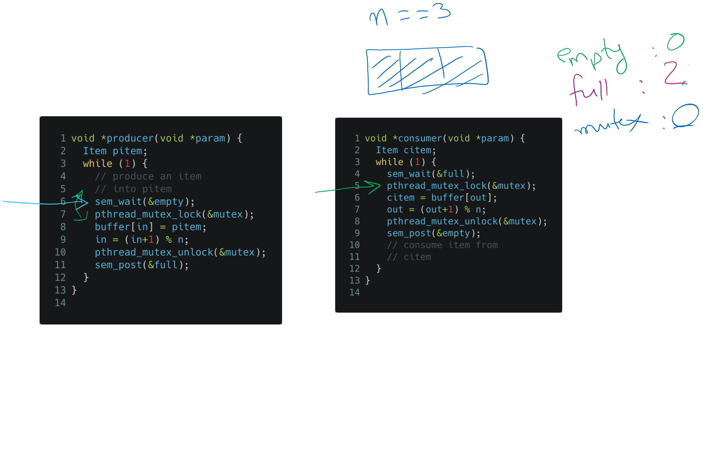
Tracing the solution

Slide 15
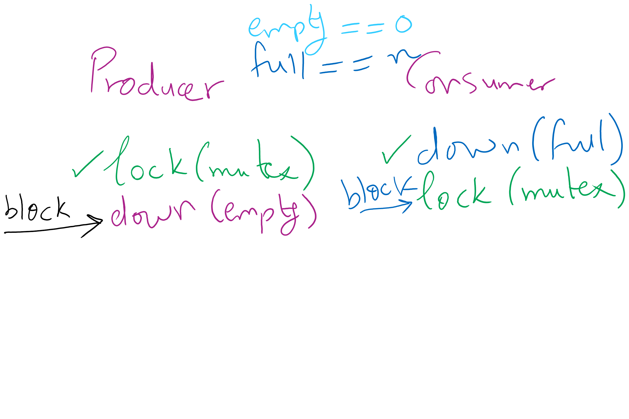
Deadlock can happen with a small mistake

Slide 16
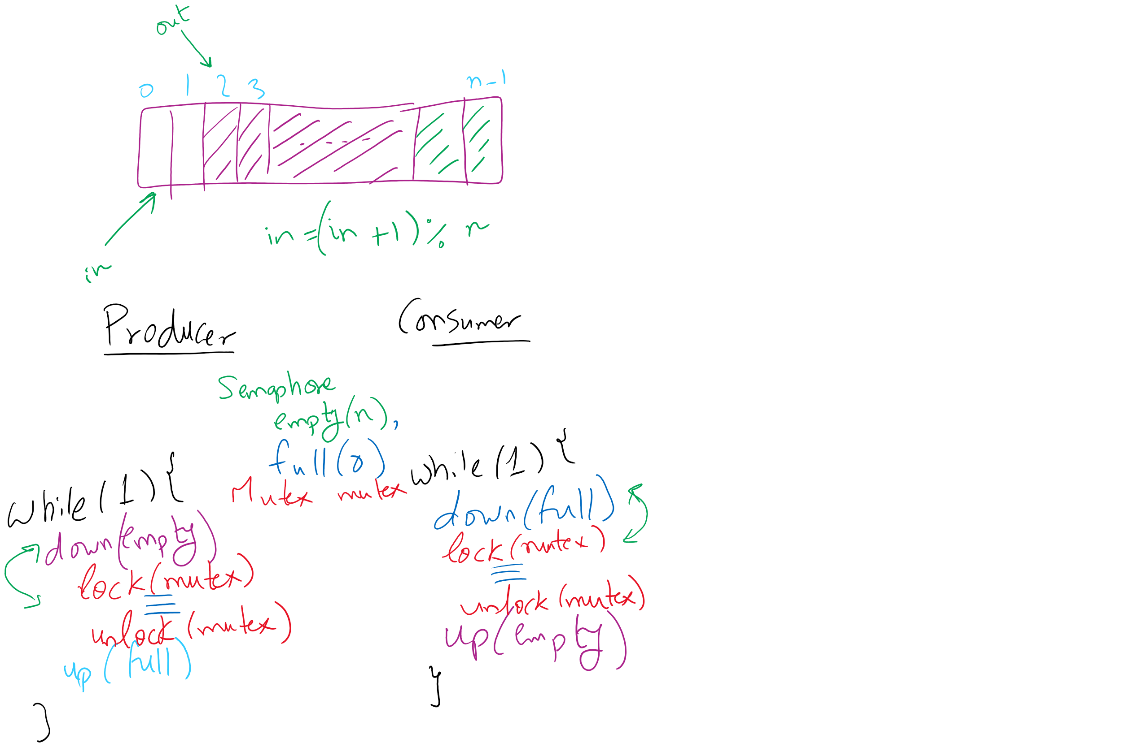
Bounded Buffer (Another rundown)

Slide 17
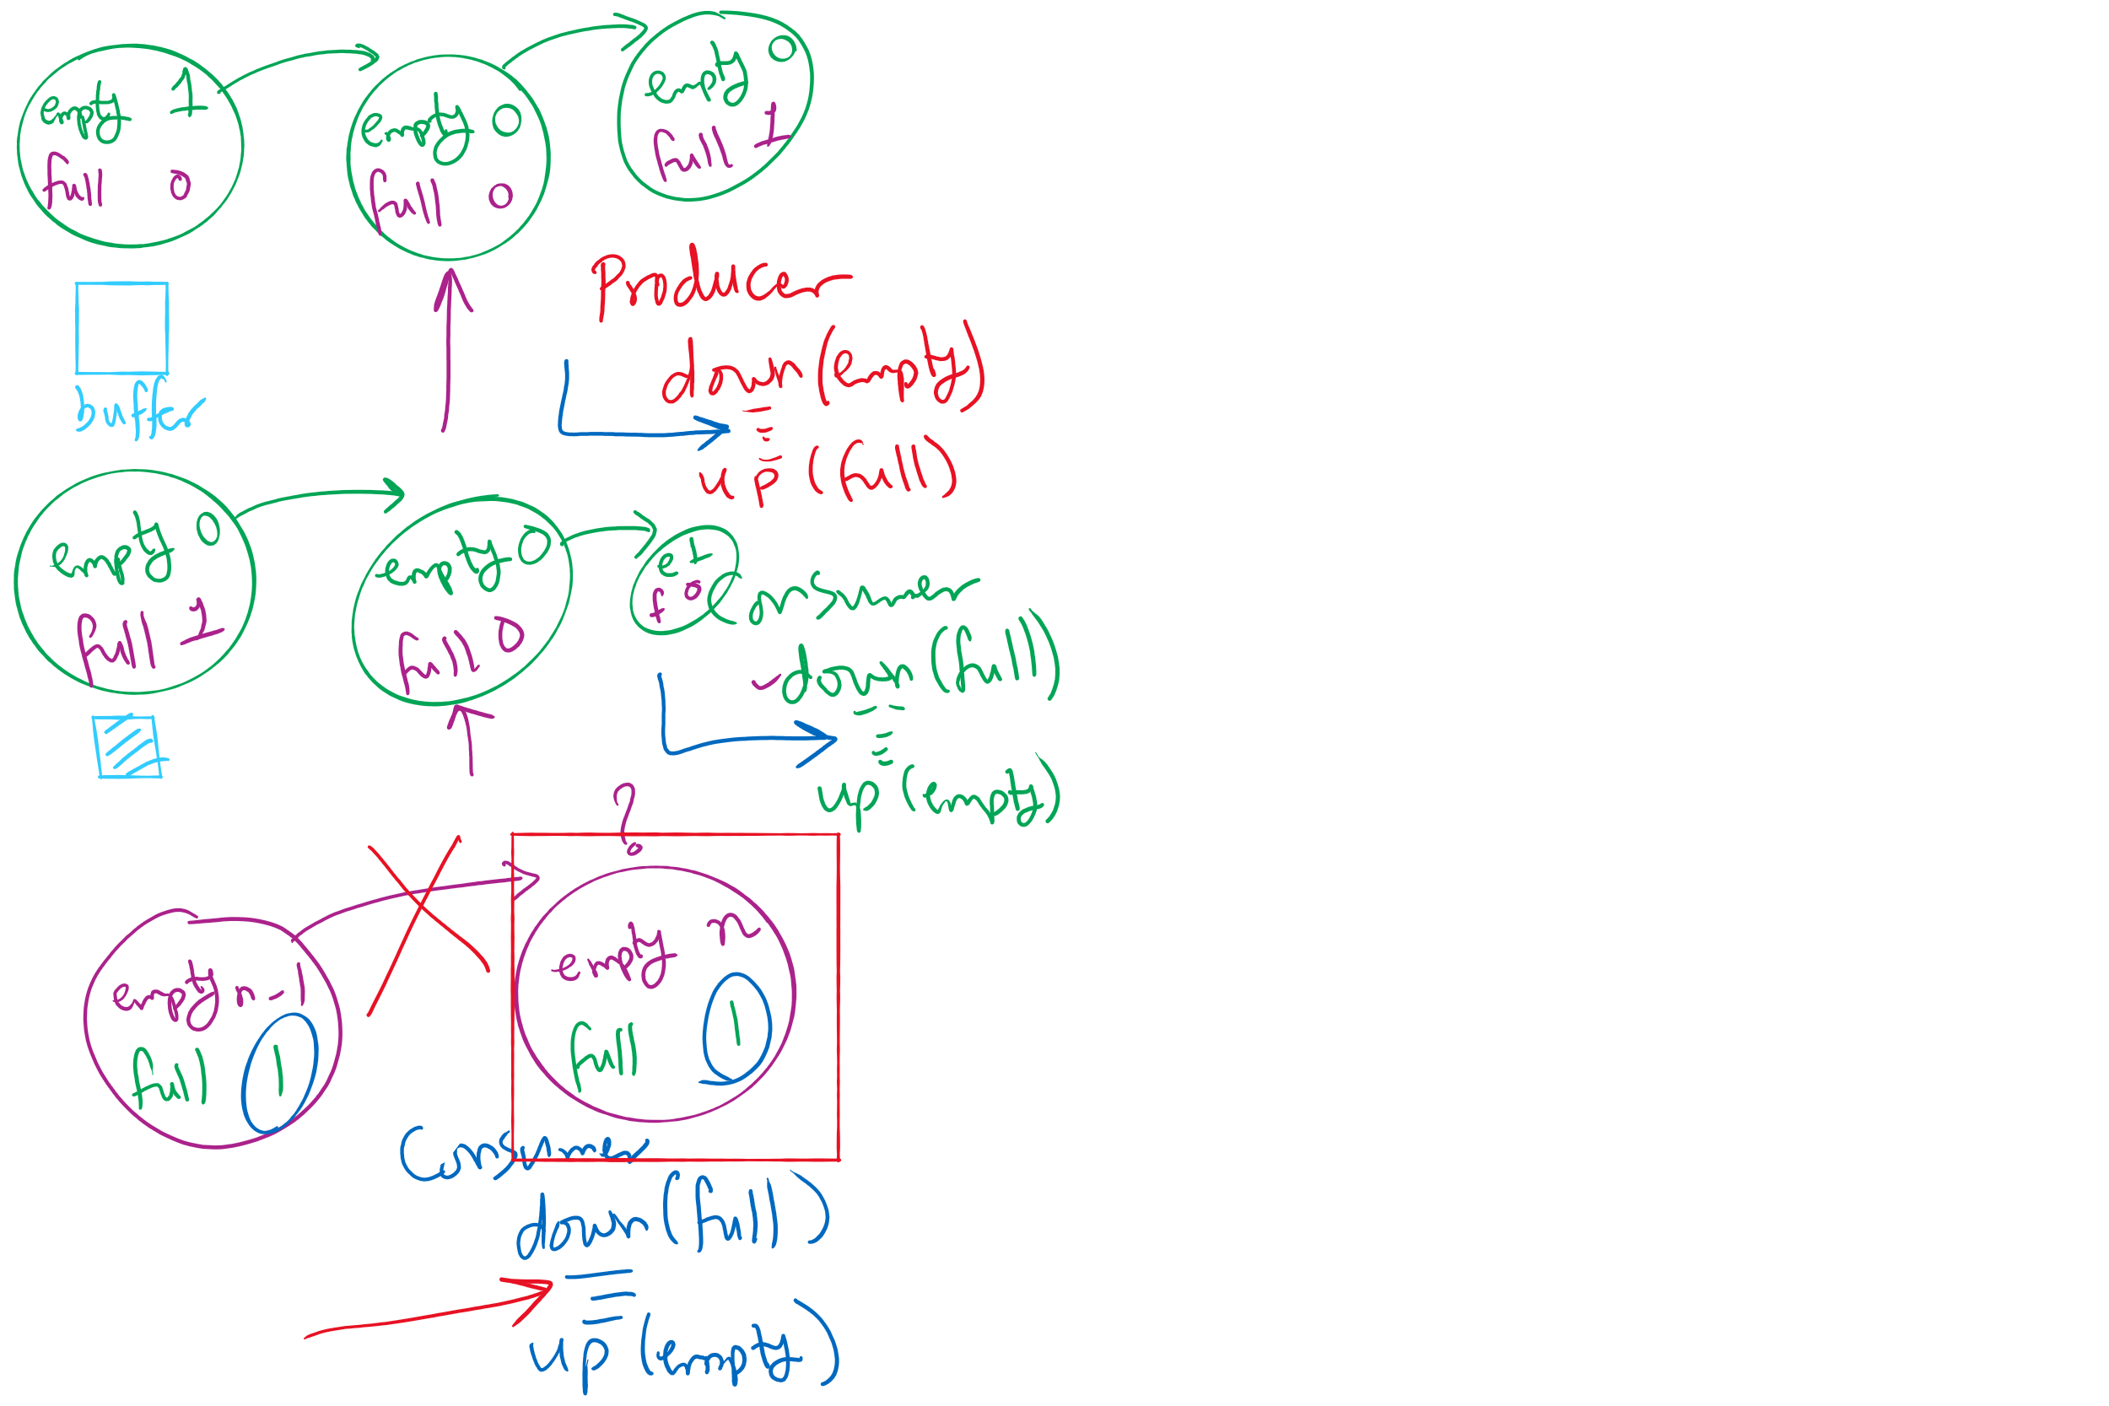
Possible states in Bounded Buffer Solution

